Slide 1


SUMMARY LESSON
1.Kinetic Theory of Ideal Gas
2. First Law of Thermodynamic
3. Engine
1
1.Superpositon Principle and Standing Wave
2.Interference and Diffraction
2
1.Magnetic Field
2. Induced Voltages and Inductance
3. Self-Induction
4. Alternating Current
3

Slide 2



Contents
1
Kinetic Theory of Ideal Gases
2
Temperature and the Zeroth Law of Thermodynamic
3
Thermometers and Temperature Scales
4
Macroscopic Description of an Ideal Gas
5
The Kinetic Theory of Gases
6
Summary

Slide 3
Lesson1 Kinetic Theory of Ideal Gases
Kinetic Theory of Ideal Gases
❍ Pressure in Kinetic
Theory of Ideal Gaes
❍ Ideal Gases equation
❍ Average kinetic Energy
of each molecules.
❍ Combined gas law
❍ Total average kinetic
Energy of molecules.
❍ Pressure of an ideal
gas exerted on the wall
❍ Isobaric process (P = Const)
❍ Elastic collision
❍ Isochoric process (V = Const)
❍ Root-mean-square
speed or v_{rms} speed
❍ Inelastic collision:
❍ Isothermal process (T = Const)
Western International School Start Your Future Today!

Slide 4

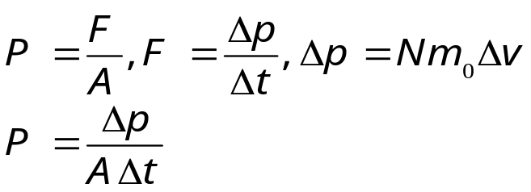
❍ SI Unit of Each Variable
Lesson1 Kinetic Theory of Ideal Gases
Pressure of an ideal gas
Gas molecules N
Volume
Average kinetic energy each molecule
Pressure in kinetic theory.
Pressure
Force
Area
Pressure
Elastic collision
Change in momentum
Duration
Mass of one molecule
Velocity
Pressure exerted on
container walls
Inelastic collision

Slide 5
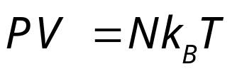
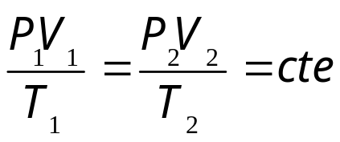
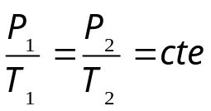
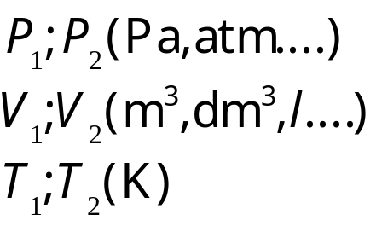
❍ SI Unit of Each Variable
Lesson1 Kinetic Theory of Ideal Gases
Gas pressure
Number of molecules
Number moles
Volume
Absolute temperature
Boltzmann constant
Universal Gas Constant
Ideal Gas Equation
Isobaric Process
Combined gas law equation
Isochoric Process
Isothermal Process

Slide 6
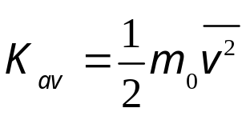
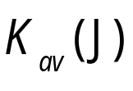
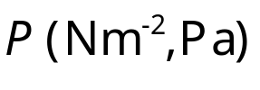
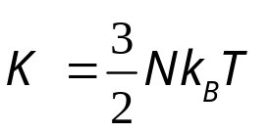
❍ SI Unit of Each Variable
Lesson1 Kinetic Theory of Ideal Gases
Average kinetic energy
Total kinetic energy
Average kinetic energy of each molecule
Gas pressure
Number of molecules
Number of moles
Volume
Mass of one molecule
Total kinetic energy
Molar Mass
Average speed
Root-Mean Square Speed

Slide 7


Key Equation
Lesson1 Kinetic Theory of Ideal Gases
Newton per meter square
Pascal
Atmosphere
Bar
Millimeter mercury
Number of moles
Pressure
Number
Avogadro’s Number
Number of molecules
Object’s mass
Volume
Temperature
Mass
Molar Mass
Mass molecules
Universal Gas constant
Constant factor
Boltzmann's constant

Slide 8




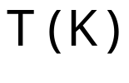

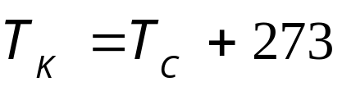
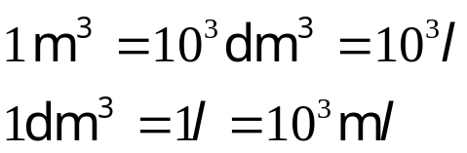
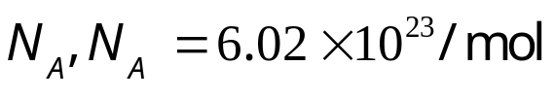
Fundamental Relation
Lesson1 Kinetic Theory of Ideal Gases
Number
Mass
Pressure
Constant coefficient
Number of moles
Molar Mass
Force
Area
Universal’s constant
Boltzmann's constant
Number of molecules
Mass molecules
Temperature
Volume
Avogadro’s numbers
Object’s mass

Slide 9




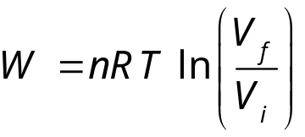

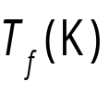




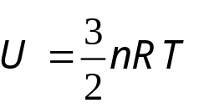
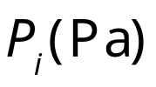


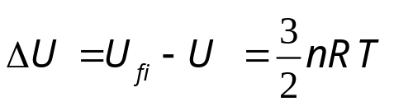

Lesson1 Kinetic Theory of Ideal Gases
Isobaric Process
Work done
Gass pressure
Channing volume
Volume
Final volume
Initial Volume
Average pressure
Final Pressure
Initial Pressure
Number of moles
Internal Energy
Final Internal energy
Initial Internal energy
Changing Temperature
Final Temperature
Initial Temperature
Heat Energy
Linearly Process
Work done
Isothermal Process
Isochoric Process
Internal energy
Heat absorb
Changing internal energy
Heat Energy
Latent Heat
Isothermal Process
Cyclic process
Adiabatic Process

Slide 10
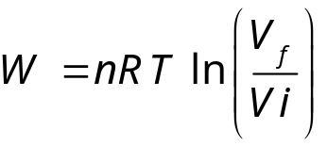



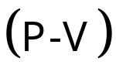
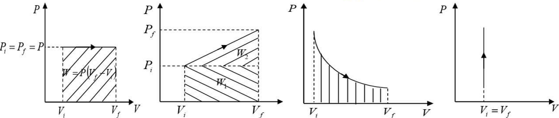
Work done and (P-V) Diagram
Lesson2 First Law of Thermodynamic
Isobaric Process
Linearly Process
Isothermal Process
Isochoric Process
Diagram
Diagram
Diagram
Diagram

Slide 11


First’s law of thermodynamics:
Lesson2 First Law of Thermodynamic
A system is defined as a set of objects chosen for study, considered in relation to its surroundings.
Sing Convention in first law thermodynamic
Heat energy Q |  | Work done W |  | Changing in internal energy ΔU
System | Sign | System | Sign | System | Sign
Absorbed | + | Does work | + | Increased in internal energy | +
Expelled | _ | Received work | _ | Decreased in internal energy | _
Adiabatic Process | 0 | Isochoric Process | 0 | Isothermal Process and Cyclic Process | 0

Slide 12


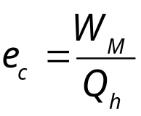
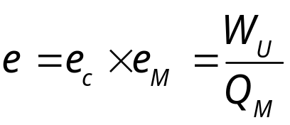
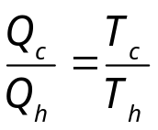

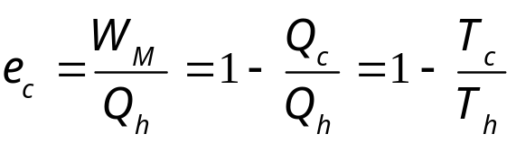
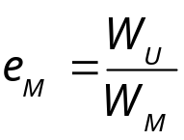
Lesson3 Heat Engine
Any engine transforms heat to do work
Internal Combustion
External Combustion
Gasoline and diesel engine
Ideal engine gives maximum efficiency
Carnot engine
Actual engine
Mechanical work
Useful work
Heat absorbed
Mechanical work
Heat absorbs
Combustion chamber
Working Fluid
Crankshaft
Heat rejected
Heat rejected
Heat rejected
Heat absorbed:
Conservation of energy:
Ratio:
Thermal efficiency:
Overall efficiency:
Carnot and ideal efficiency:
Crankshaft energy:
Mechanical efficiency:

Slide 13
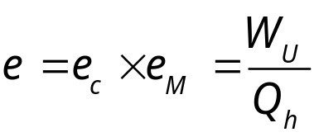

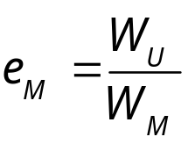
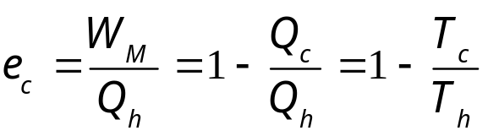
Lesson3 Heat Engine
Theoretical heat engine gives maximum efficiency
Carnot engine
Actual engine
Heat absorbed
Mechanical work
Heat absorbed
Mechanical Work
Useful work
Combustion chamber
Crankshaft
Working Fluid
Heat rejected
Heat rejected
Heat rejected
Heat absorbed by working fluid Q_{h} (J)
Heat absorbed by a combustion chamber is Q_{h} (J)
Heat rejected by a combustion chamber is Q_{c} (J)
Mechanical or energy delivered by a crankshaft is W_{M} (J)
Mechanical work is W_{M} (J)
Heat rejected by a crankshaft is Q_{L} (J)
Heat rejected by work fluid Q_{c} (J)
Mechanical work W_{M} (J)
Carnot or ideal efficiency

Slide 14
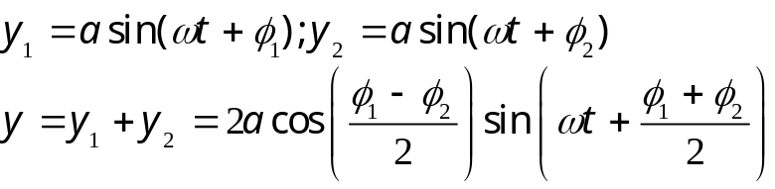



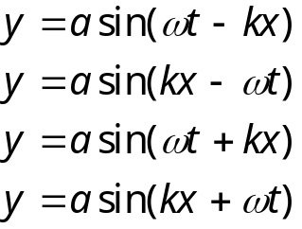

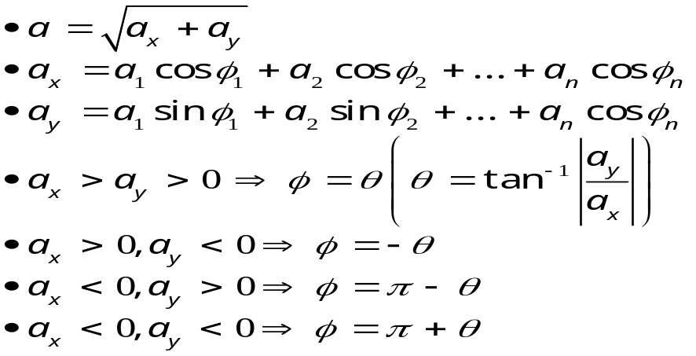
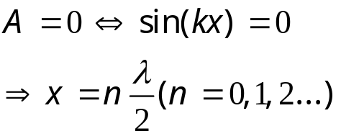
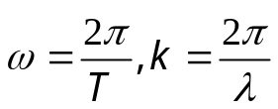
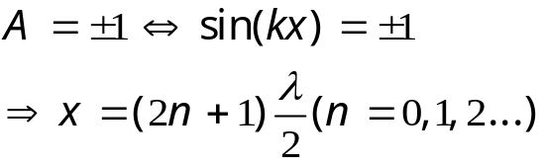
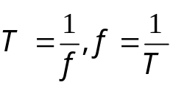
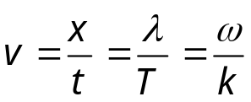
Superposition and Standing Wave
Sinusoidal wave is the wave that has constant amplitude and period.
Standing wave is a wave formed by two or more waves propagate in a medium.
Standing wave is a wave formed by two or more waves propagate in a medium in the opposite direction.
Method1:
Equation
Standing wave equation:
Wave equation
Amplitude:
Right direction
Method2:
Minimum amplitude
Left direction
Wave speed:
Maximum Amplitude
Angular frequency:
Period and frequency:

Slide 15
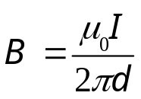
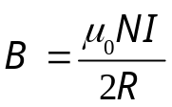
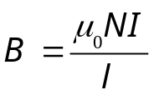

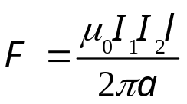

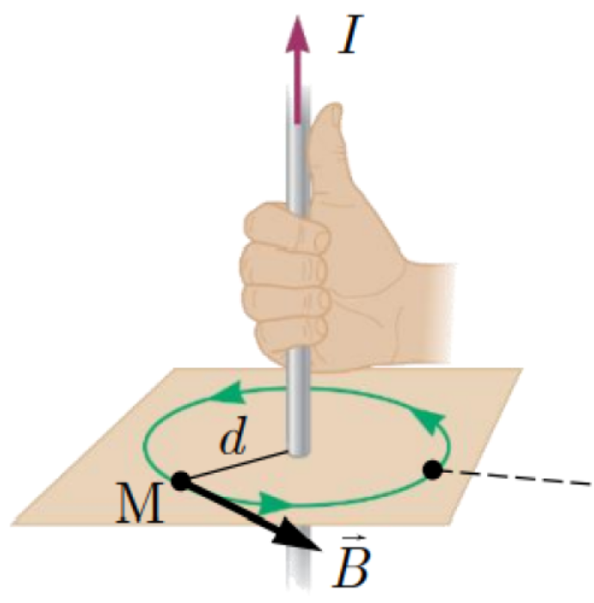
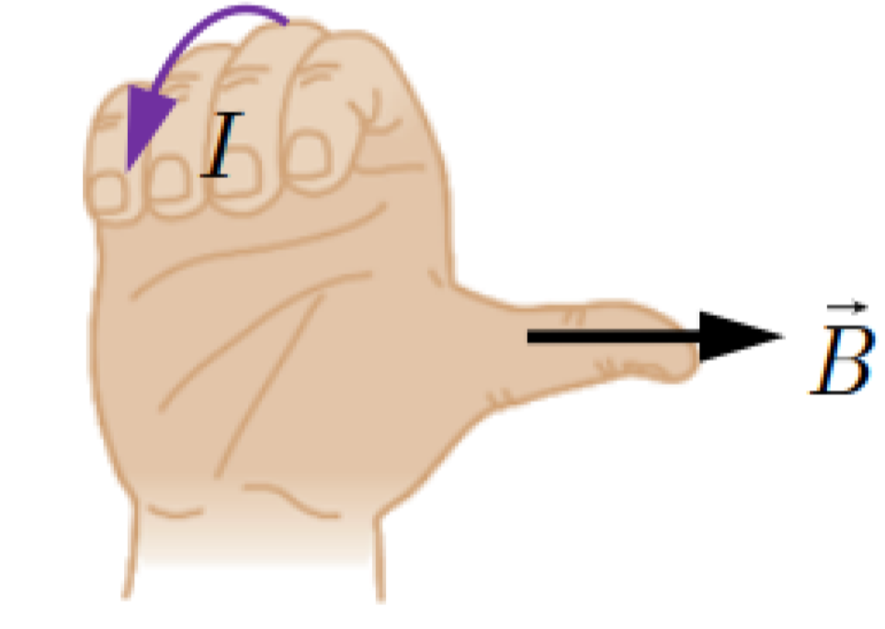
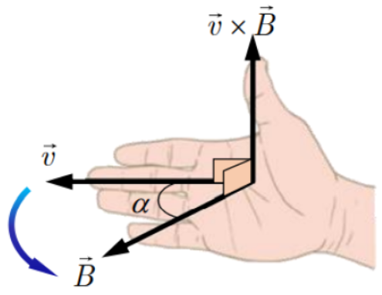
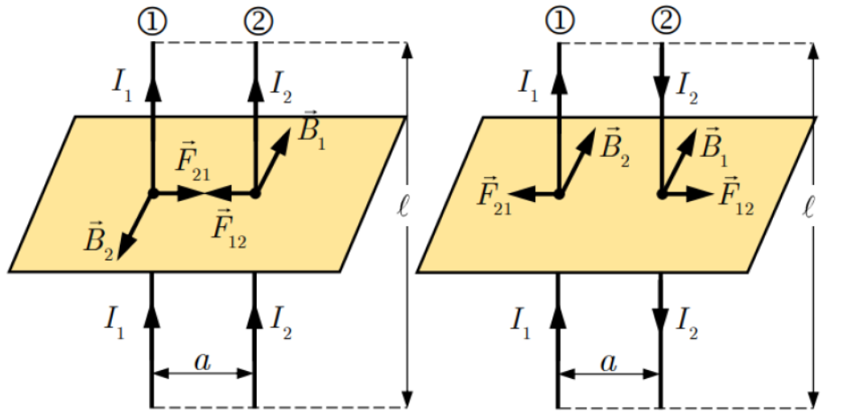
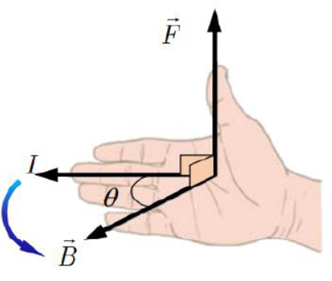
Lesson1 Magnetic Field
Magnetic field in current carrying wire
Magnetic force or Lorentz force
Stright wire
Circular wire
On a charge in the magnetic field
On current wires
Over a distance d from the wire
Coils
Solenoid
Lorentz force
Two parallel wires
Wire in a uniform magnetic field
Direction
Direction
Direction
Direction
Direction
Magnetic field lines

Slide 16

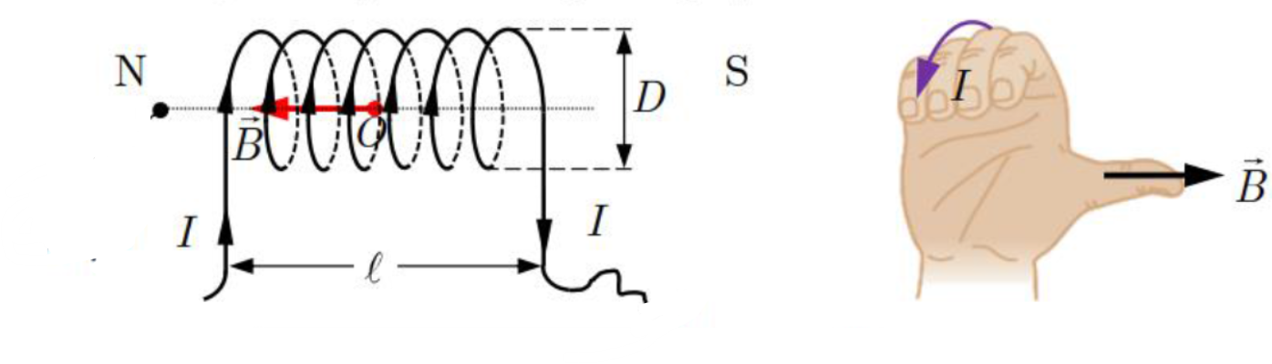


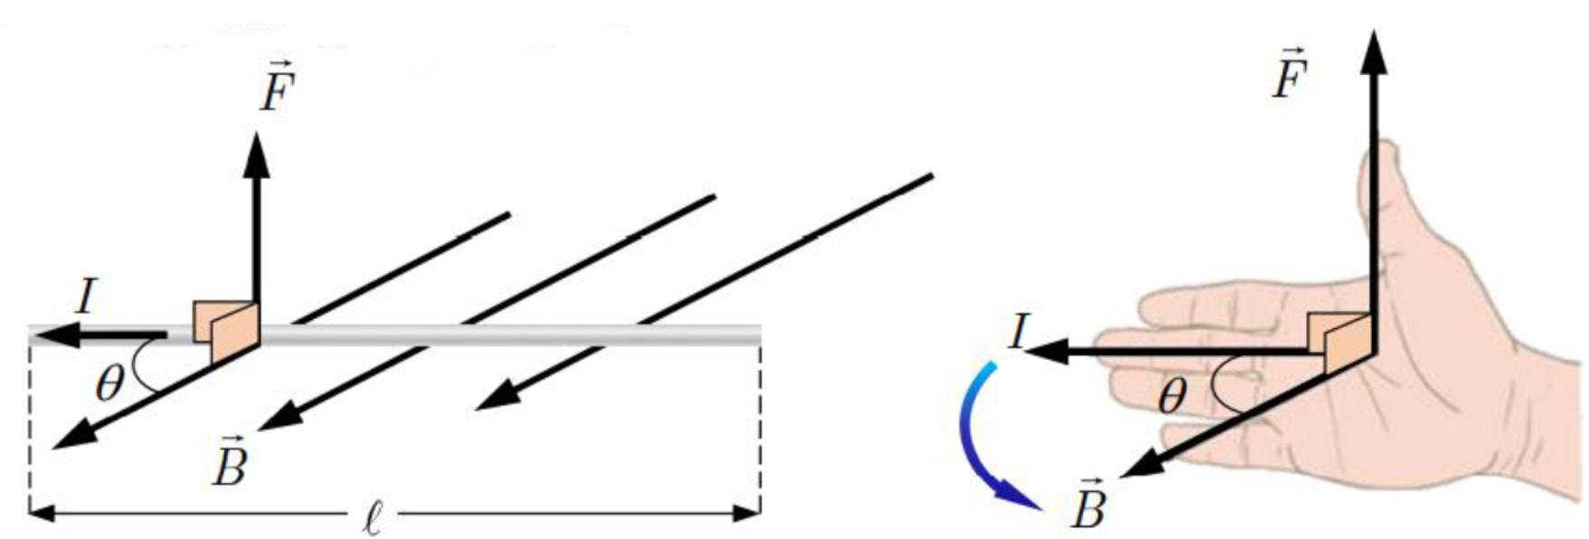

Lesson1 Magnetic Field
Magnetic field due to a straight current carrying wire
 Point of application at a point located at a perpendicular distance d from the wire.
 Direction is perpendicular to the plane containing the wire.
 Direction: Thumb points in current, fingers curl in field direction.
 Magnitude:
Magnetic field due to a circular wire
 Point of application is taken at the center of the circular loop.
 Direction is directed perpendicular to the plane of the loop.
 Direction: Fingers follow current, thumb points along B.
 Magnitude (Coil) (Solenoid)
Magnetic force on a current carrying wire in a uniform magnetic field
 Point of application at the midpoint of the wire.
 Direction is perpendicular to plane of current I and magnetic field B.
 Direction: Palm along I, curl to B, thumb shows F.
 Magnitude
Magnetic field lines

Slide 17
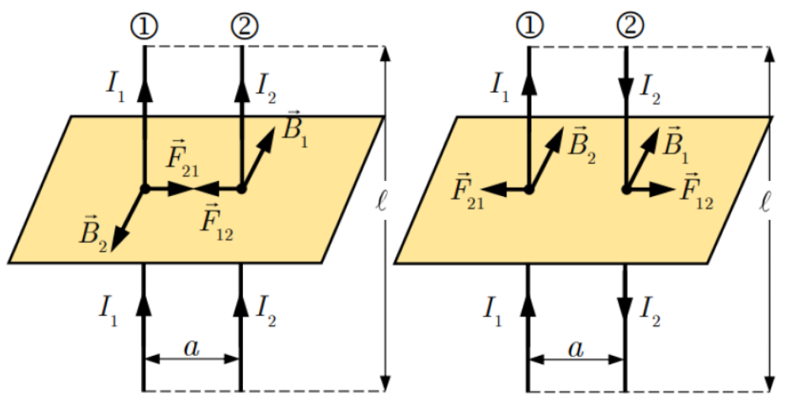



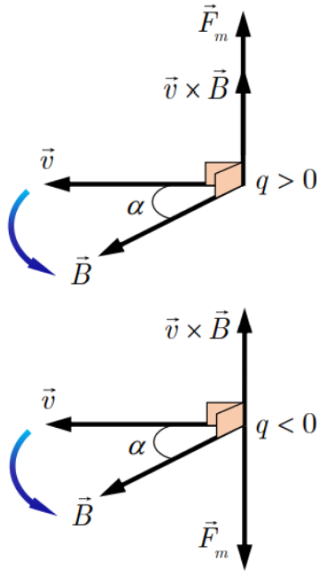



Lesson1 Magnetic Field
Magnetic field formed by two parallel wire
 Point application at the center of each wire
 Direction is perpendicular to I–B plane..
 Direction: Palm along I, fingers curl B, thumb shows F.
​ If ​ , the force between them is attractive.
 If , the force between them is repulsive.
 Magnitude
Magnetic field experiencing on a charged particle (Lorentz force)
 Point of application at the location of the charged particle.
 Direction is Perpendicular to velocity–B plane.
 Direction: Fingers along v, curl to B, thumb shows F
​ If
 If
 Magnitude

Slide 18






















Lesson1 Magnetic Field
Straight current wire:
Magnetic field
Permeability of free space
Current
Distance from wire
Number of turns
Radius of a loop
Length of the solenoid
■ SI Unit of each variable
Over distance d from wire
Magnetic Field Produced by an Electric Current
Coils:
■ Note:
Circular wire
Relative permeability
Solenoid:
Permeability of free space
Magnetic force
Magnetic field
Current
Length of wire
Distance between two wires
Electric charges speed of a charge
Permeability of the material
​​ A wire in magnetic field
On current
Two parallel wires
Electromagnetic force
On a charged in
magnetic field

Slide 19




















How to determine the number of turns and resistance of the solenoid.
 Number of turns
 Number of turns
 In case
 In case
 In case
 Resistance of the wire (solenoid)
 Length of the wire
 Area of the wire
 Number of turns​
 Length of the solenoid
 Diameter of the solenoid
 Radius of a solenoid
 Area of a solenoid
 Number of layers
 Resistance of the wire
 Resistivity of the wire
 Diameter of the wire
 Radius of wire
 Area of the wire
 Thickness of the insulation
Thickness of insulation
Area of the wire

Slide 20

















The path of the electric charged moved in the uniform magnetic field
In case
In case
In case
Magnetic force
Magnetic force
Magnetic force
Linear path
Spiral path or circular path
Circular path
Magnetic force
Magnetic field
Electric charge
Speed of the charge
​​ ​​​​​ Angle between
Radius
Period
Mass of the particle
Period
Circle

Slide 21







Lesson2: Induced emf​
Experiment
Magnetic flux
Change in magnetic flux
Induce emf
A moving conductor in a magnetic field
Generator
Faraday’s law
Closed circuit
Average
Magnitude
Reversibility
Induce current
Direction
Magnitude
Electric motors
Ohm’s law
Lenz’s law

Slide 22
















SI Unit of each variable in the formula
Magnetic flux
Magnetic field
Number of turns
Area of a closed circuit
Angle between
Normal vector
Magnetic flux:
because
because
Changing in magnetic flux
Findal magnetic flux
Initial magnetic flux
Changing in magnetic flux:

Slide 23


















SI Unit of each variable in the formula
Electromotive force
Changing in magnetic flux
Duration
Derivative of flux
Faraday’s law
Induce electromotive force
A bar wires in a magnetic field
Electromotive force
Magnetic field
Speed of the wire
Length of the wire
Angle between
Area
Angular frequency
Generator
Induced current
Induced emf
Induced current
Resistance
Induced emf
Magnetic field
Number of turns

Slide 24
















Lesson3 Self Induction
Changing current
Duration
Derivative respect to time
Inductance
Self induced electromotive force
Changing in magnetic flux
Number of turns
Area of the solenoid
Length of the solenoid
Permeability of free space
Changing current in a coil
Relationship between current and magnetic flux
Changing magnetic flux in a coil
Magnetic field of a solenoid
(Air-core)
Self induced emf
(Core)
Magnitude
Instantaneous value

Slide 25











Lesson3 Self Induction
RL Circcuit
When the switch is closed
Voltage Equation
Differential equation of current
Studies at instance t
Instantaneous current
Time constant
Peak current

Slide 26










Lesson3 Self Induction
RL Circuit
When the switch is opened
Voltage equation
Differential equation of current
Studied at instance t
Instantaneous current
Time constant:
Peak current

Slide 27







Lesson3 Self Induction
RL Circuit
When the switch is closed
Conservation of energy in LC the oscillation
Maximum energy stored in a capacitor
Maximum energy stored in an inductor
Energy stored in a capacitor
Energy stored in an inductor

Slide 28













Lesson3 Self Induction
RL Circuit
Closed the switch
Voltage equation
Instantaneous voltage
Angular frequency
Instantaneous charge
Period
Instantaneous current
Alternatively
Angular frequency

Slide 29



Lesson4 Alternating Current
1. General State
1.1. Definition of direct current
 Alternating current is the current that changes its direction two times in one cycle.
 The simplest current is the sinusoidal current. Sinusoidal current is in the form:
 Instantaneous current at instant t
 Maximum current or amplitude
 Angular frequency
 Instant phase
 Initial phase at t = 0

Slide 30








Lesson4 Alternating Current
1.2. Value table for current and voltage in the circuit
 In an alternating current (AC) circuit, the values of current and voltage can be expressed in
three different forms.
 | Instantaneous value | Maximum value | RMS Values
Current
Voltage
 RMS current or voltage produces same heating as DC in same duration.
 Ohm’s law applied in alternating current: V = ZI , where Z is the impedance.”

Slide 31










Lesson4 Alternating Current
1. Resistance in R, L, C Alternating Circuits
1.1 For Resistor
 We have:
​ Ohm’s law where R is resistance measured in
 Instantaneous current
 From equations (1) and (2), we see that for a resistor, the current and voltage are in phase.
 Fresnel diagram
Since where
​ And where

Slide 32












Lesson4 Alternating Current
2.2 For capacitor
 In alternating circuit, ​value of current and voltage divided into three
 We have
 Ohm’s law where is the impedance of the capacitor .
 Instantaneous current:
 From equations (1) and (2), we see that the current leads the voltage by 90°.
 Fresnel diagram
Since Where
And Where

Slide 33










Lesson4 Alternating Current
2.3 For inductor
 We have:
 Ohm’s law where, Z_{L} is the impedance .
 Instantaneous current:
 From equations (1) and (2), we see that the current lags the voltage by 90°.
 Fresnel
​Since Where,
And Where,

Slide 34









Lesson4 Alternating Current
3. RLC Series Circuit in Alternating current
3.1. In case of RLC series circuit:
 We have instantaneous current:
 Construct Fresnel diagram relative to
 From the Fresnel diagram on the right-hand side
Maximum voltage and rms voltage in series circuit
Impedance Z in RLC series circuit

Slide 35






Lesson4 Alternating Current
 Phase Angle φ of RLC Series Circuit
 Phase Shift in RLC Series Circuit:
 If
 From equation (1) and (2)
 Thus, the current lags the voltage, or equivalently, the voltage leads the current.

Slide 36




Lesson4 Alternating Current
 If
From equations (1) and (2), we see that the current lags the voltage,
or equivalently, the voltage leads the current
 If
From equations (1) and (2), we see that the current and voltage are
in phase. In this case, resonance occurs, producing maximum
current in the circuit.
Note: They can also construct a Fresnel diagram for the RMS
voltage V and impedance Z in a series RLC circuit, since the
voltages across R, L, and C combine vectorially. Since

Slide 37


Lesson4 Alternating Current
 Special cases RC
Hence, the current leads the voltage
 Special case RL
Hence, the current lags the voltage

Slide 38









Lesson4 Alternating Current
4. ​ Average power and power factor of ac circuit
 We have
 Hence, average power Where is the power factor
 Note:
 For pure resistor R, therefore
 For pure inductor L, therefore
 For pure capacitor C, therefore
 In RLC series circuit, therefore
 In RLC parallel circuit, therefore

Slide 39





Lesson4 Alternating Current
5. ​ Transformers
A transformer is a device made of two parallel iron cores joined together, with wires wound around the ends to form coils.
 Power and equation
 Efficiency of a transformer:
 Turn ratio of a transformer:
 Is called step up transformer.
 Is called step down transformer.

Slide 40


